Slide 1

Data Pipeline Project
Web Scraping
Data Storage
Data Cleaning
By Yumeng Sun

Slide 2
Project Purpose
Collecting data of used cars with selenium, requests and multithreading
Storage data in data lake (s3)
Cleaning data for future machine learning and AI projects
Ultimate purpose is to predict prices of used cars given variables such as make, mileage, engine type etc.

Slide 3
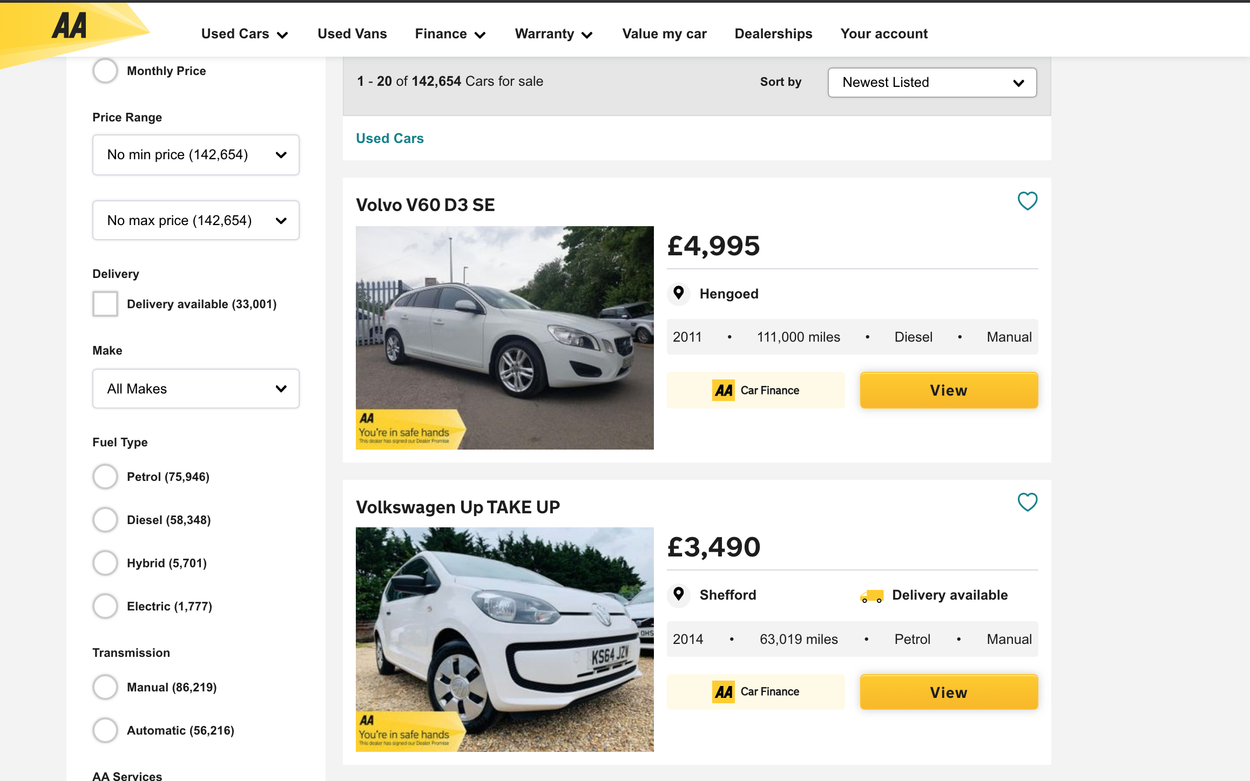

Scraping Part One URL List or Getting Individual Car Details
20 cars shown per page
‘View’ contains URL of individual car details
143,654 cars to be scrapped
Web Driver

Slide 4
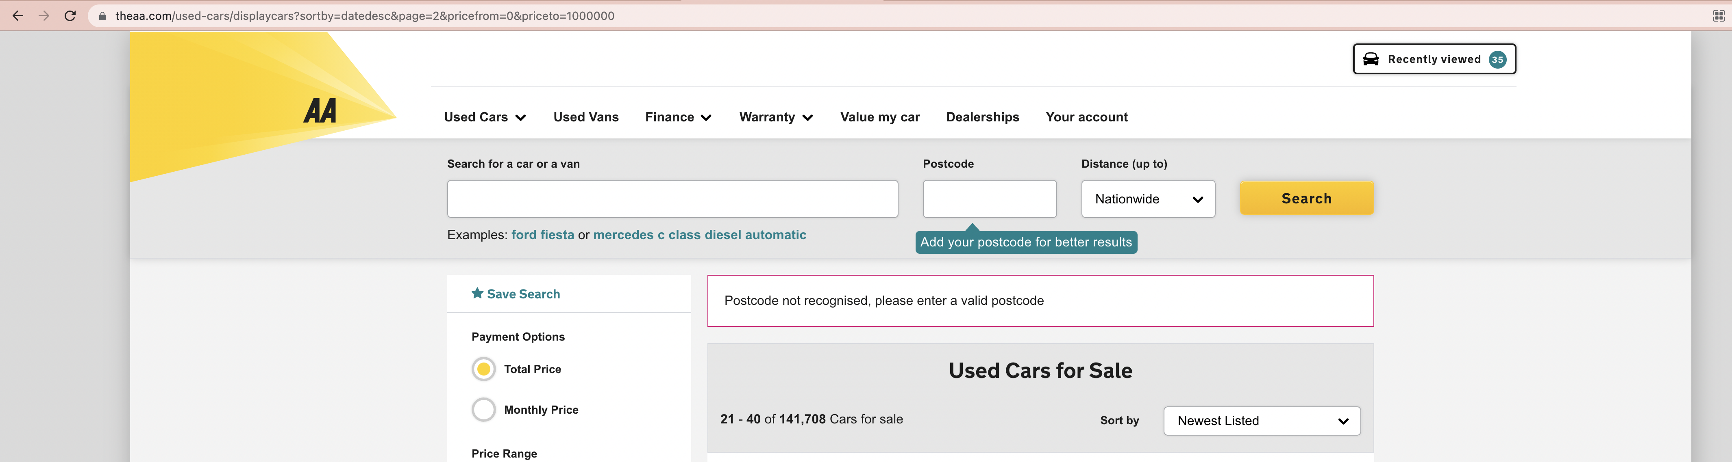
Access pages by changing {page= } URL
View by newest listed for future scraping
Compare requests and selenium for craping car details

Slide 5
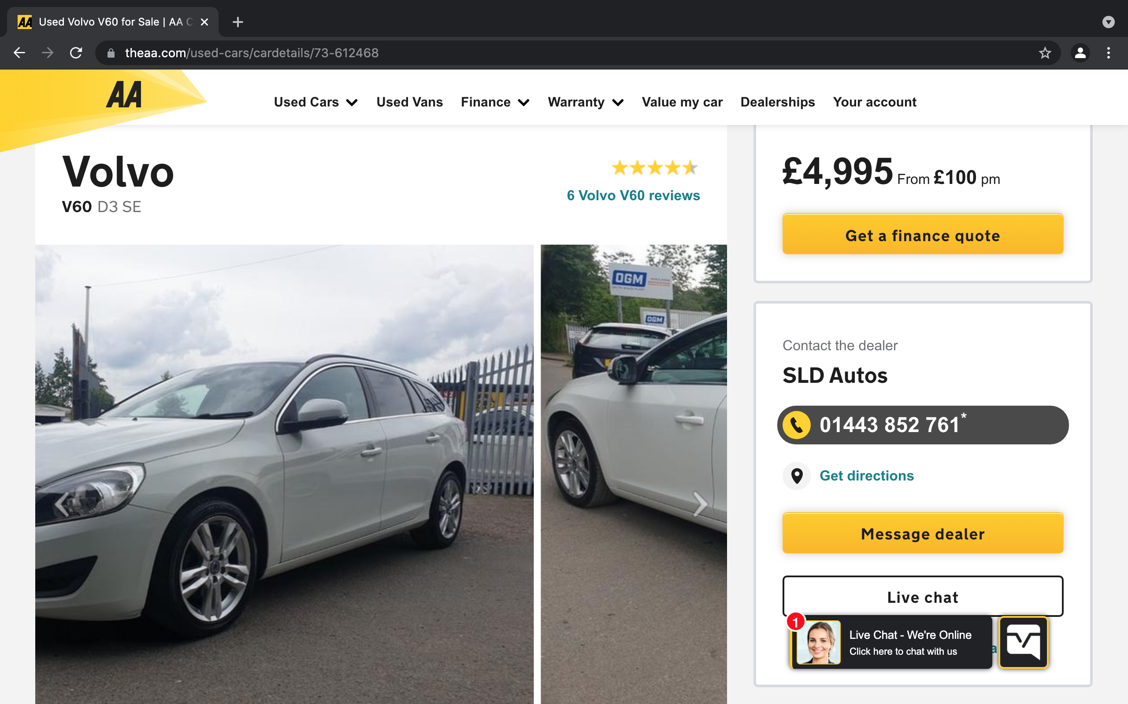
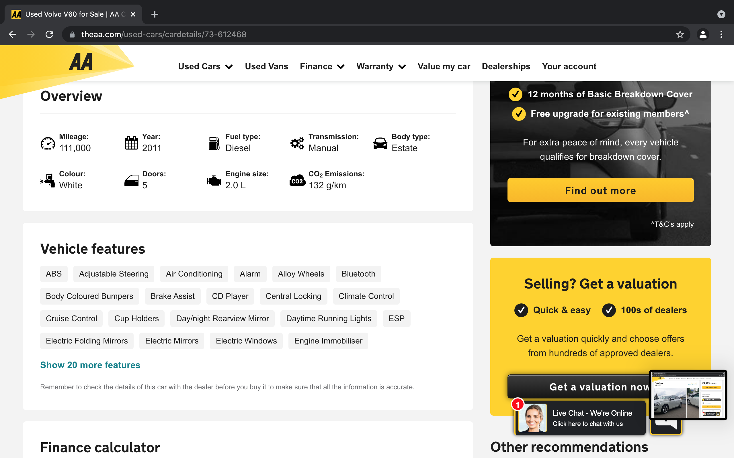
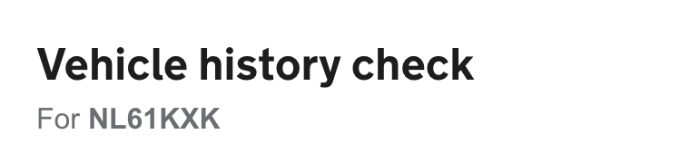
Scraping Part Two Getting Individual Car Details
Car Price (Target)
Car make
Car model
Milage
Year
Fuel type
Transmission
Body type
Color
Doors
Engine size
License Plate
Image URL

Slide 6
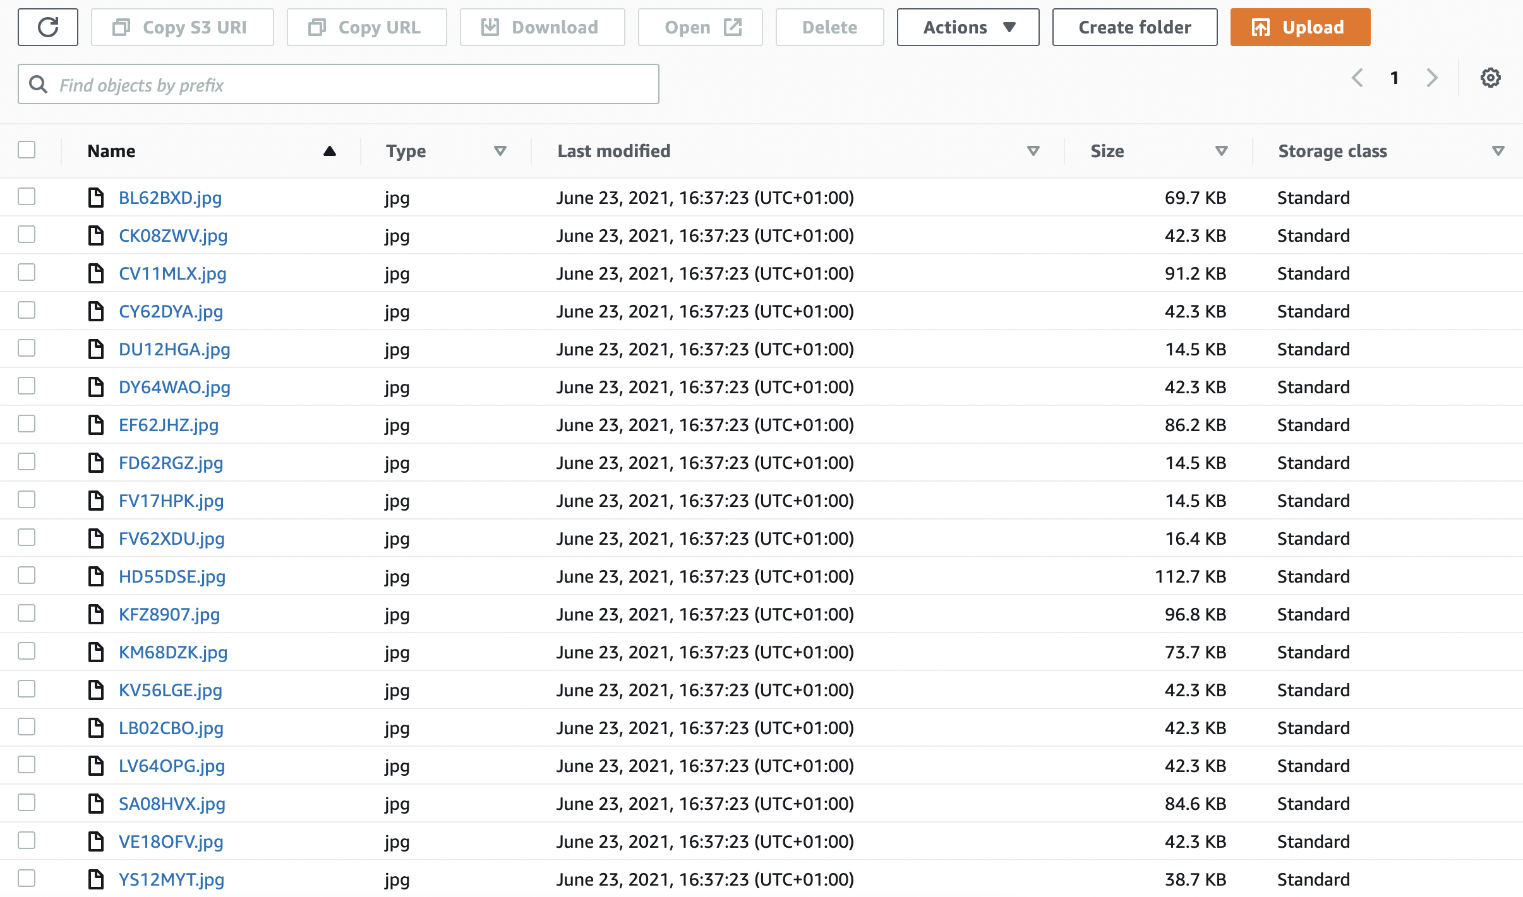
Data Storage
Download
Download images of cars
Upload
Upload to S3 using boto3
File
Save scraping results as csv file
Append
Append file for more car details

Slide 7
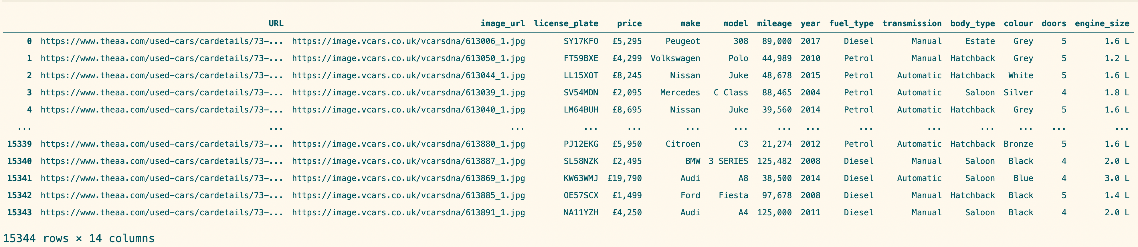
Data Cleaning
license_plate:
drop nan, drop duplicates
price:
strip'£', replace ',' with'', to float
mileage:
replace ',' with'', to float
doors:
to float, replace '0' with 'np.nan'
engine_size: replace co2 emission values with np.nan, strip’L',

Slide 8
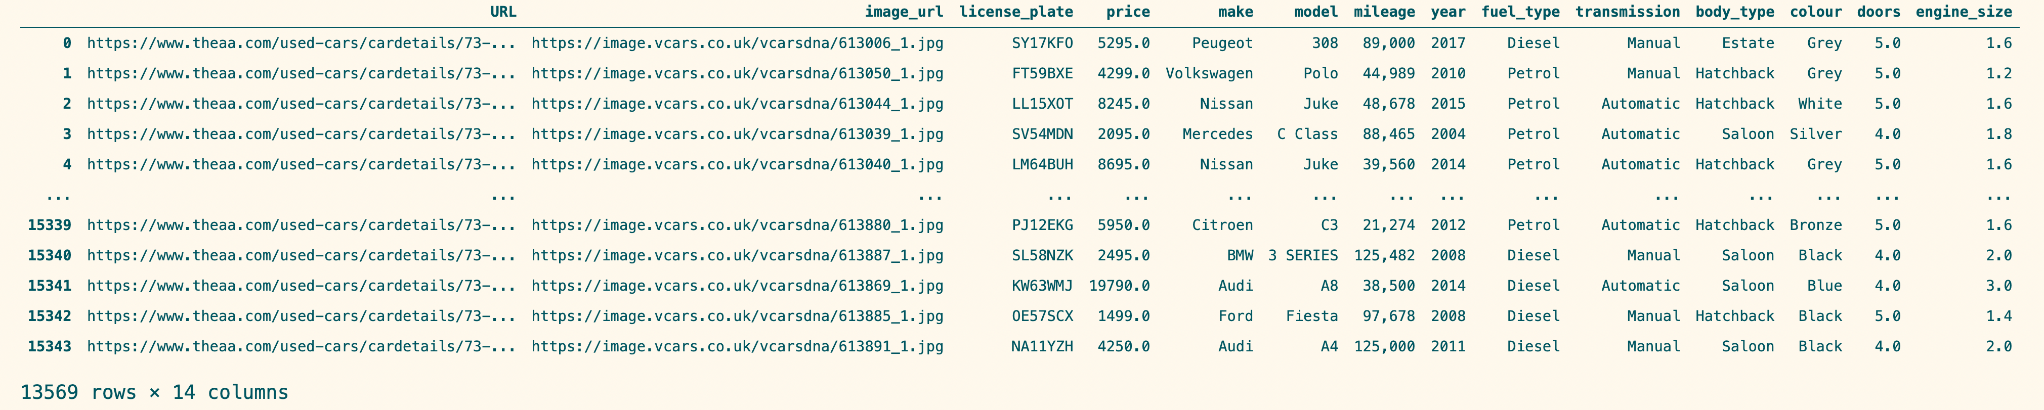
Cleaned Data

Slide 9

Thank you!

